Slide 1
State-dependent network interactions differentially gate sensory input at the motor and command neuron level in Caenorhabditis elegans Revisions
4/23/24

Slide 2
File System
All data: /nadata/mnlsc/home/ztcecere/ProcAiryData2
All bacteria stimuli cells:
Yfull_op50_SF.npz
Stimulus Sequence:
inpfull_op50_SF.npz
Clustered:
Yanno_op50_SF.npz
Same stim

Slide 3
STA

Slide 4
Worm 2: pearson corr distance
135 cells
Lambda ~0.01

Slide 5
Worm 2 pearson^2 (normalized) Data
Lambda: 5.03559

Slide 6
Worm 2 pearson^2 Data
Why does changing dimension (2,8 →15) range in all_fits change the radii values?

Slide 7
All worms - Pearson
948

Slide 8
All worms Clustered

Slide 9
STC
Spike triggered covariance
For calculation: Flip the bacteria (stimulus) and calcium (response) because

Slide 10
MID

Slide 11
MNE

Slide 12
Misc. Notes
Figure creation
Font: ariel
Clustering Algorithm

Slide 13
Testing AVA/RME Clusters
Stim_1 ( worms 2,3,4,5) starting at idx 0

Slide 14
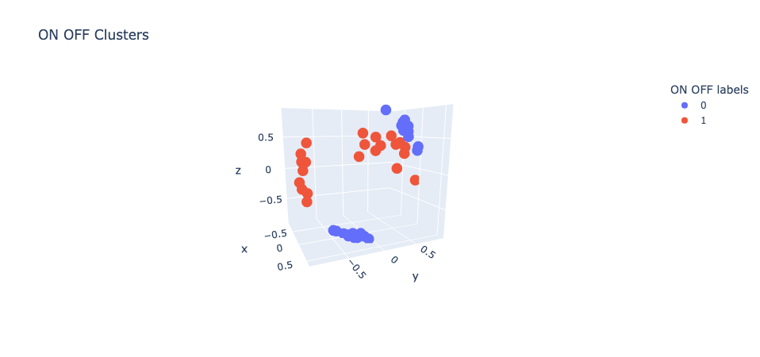
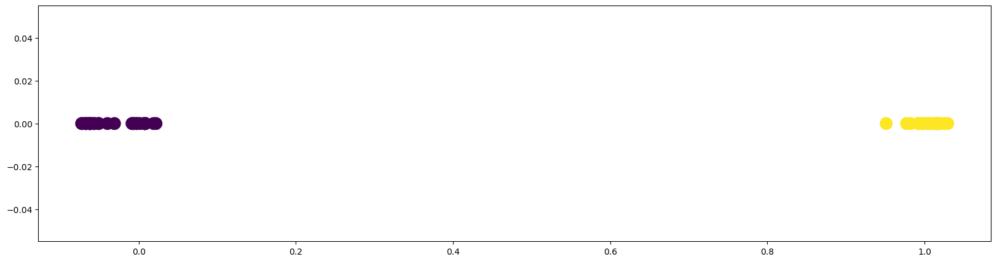
ON/OFF Clusters

Slide 15
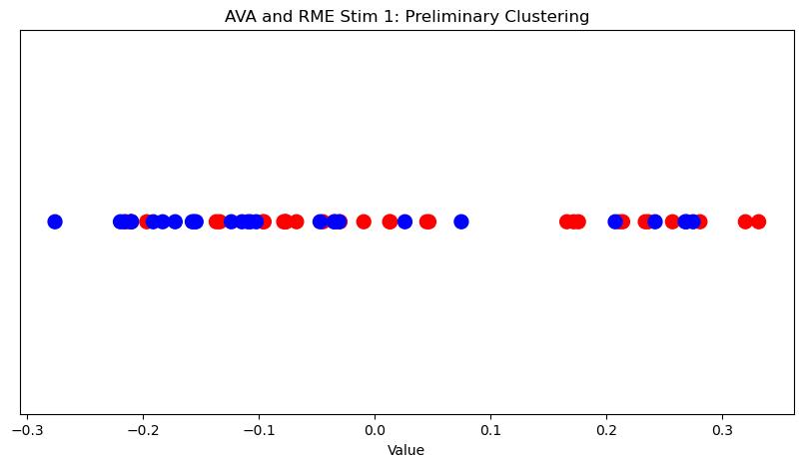
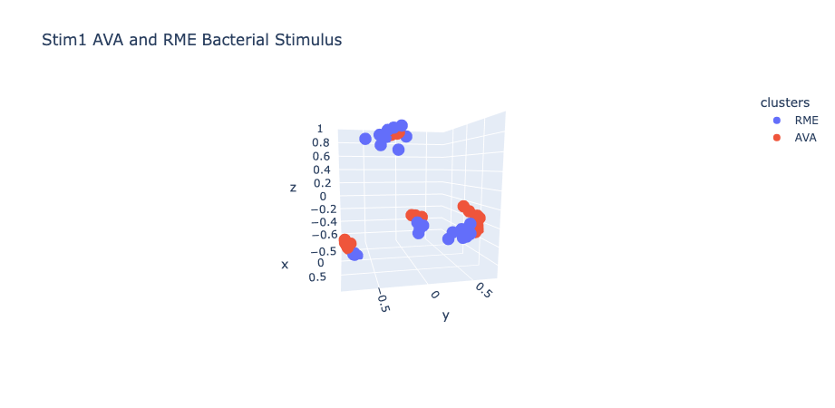
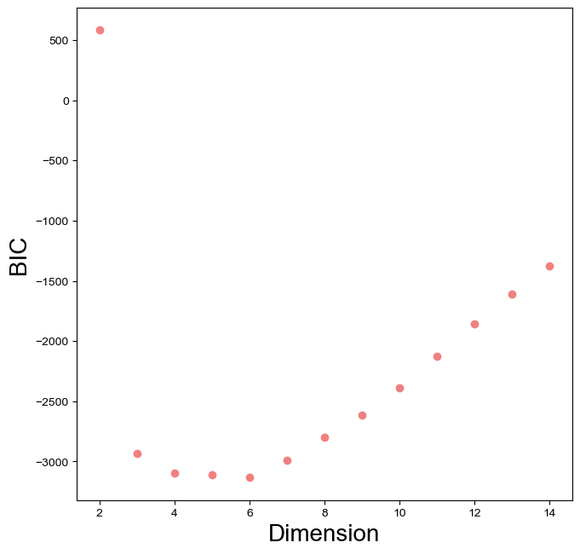
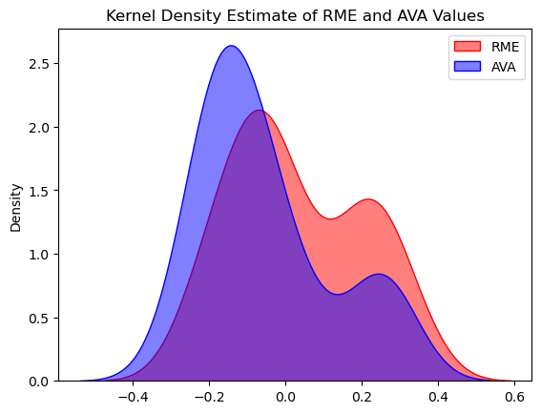
Testing AVA/RME Clusters

Slide 16
Test AVA/RME clusters for stim 0 - Logistic Regression

Slide 17
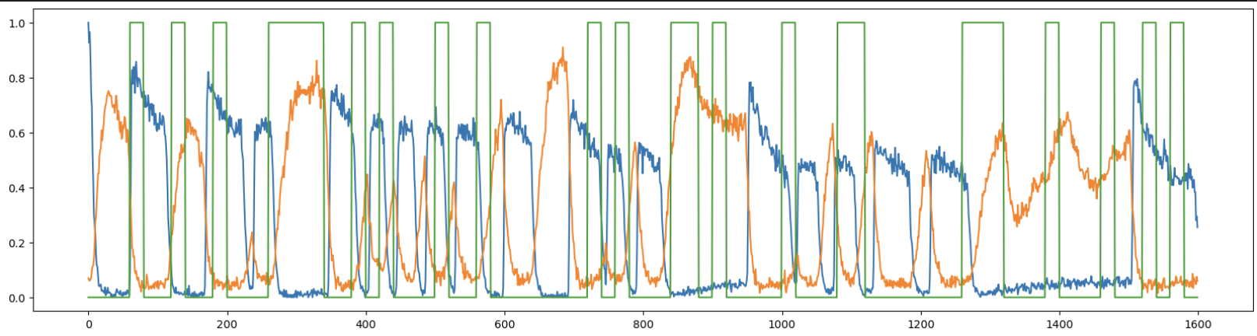
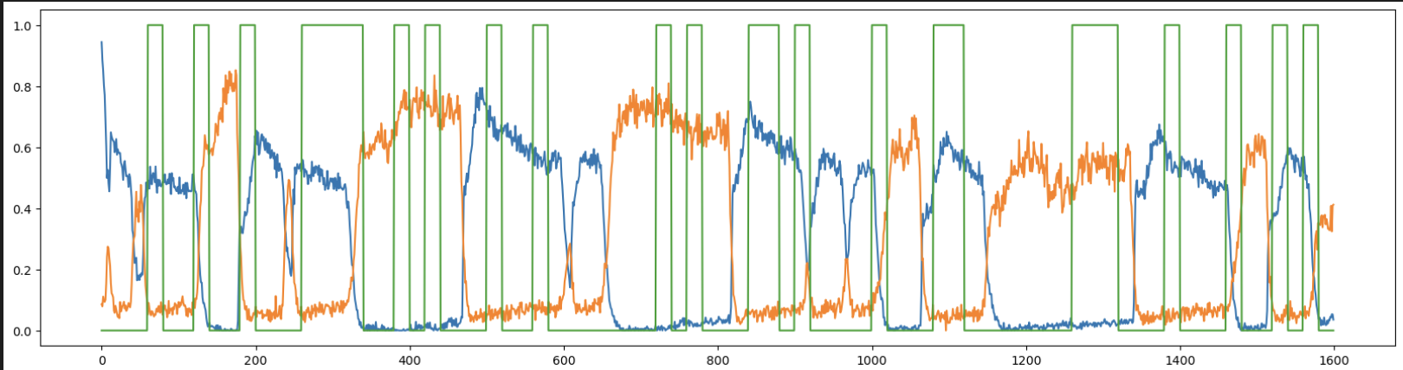
RME/AVA suspected clusters
Yanno[‘arr_2’] cell 0, cell 1
Yanno[‘arr_4’] cell 0, cell 1

Slide 18
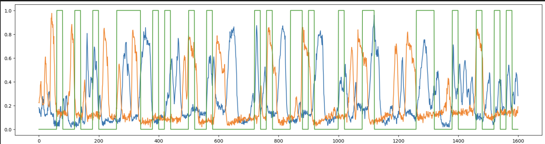
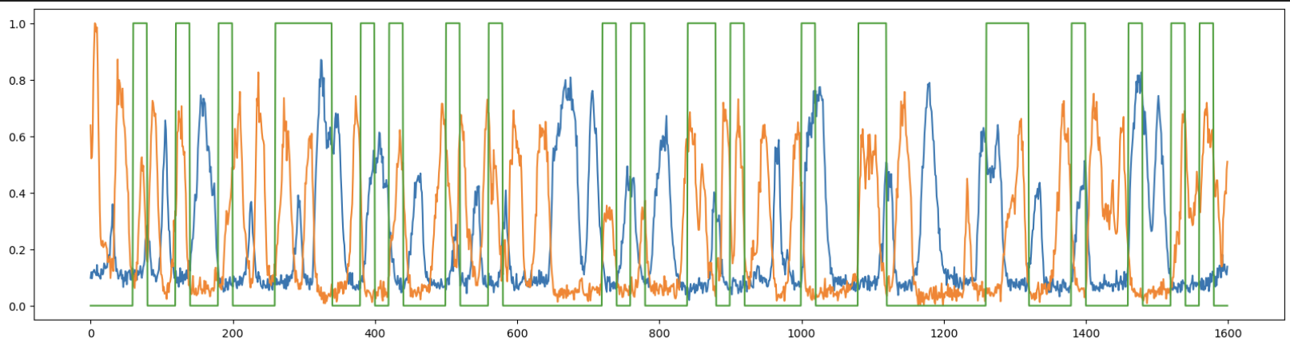
SMDD/SMDV
yanno['arr_3'][:, 2]
yanno['arr_3'][:, 3] ) #orange
yanno['arr_4'][:, 2] ) #blue
yanno['arr_4'][:, 3] ) #orange

Slide 19
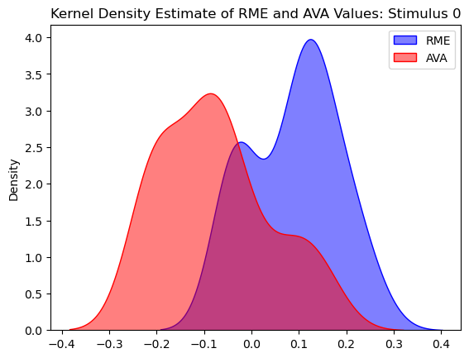
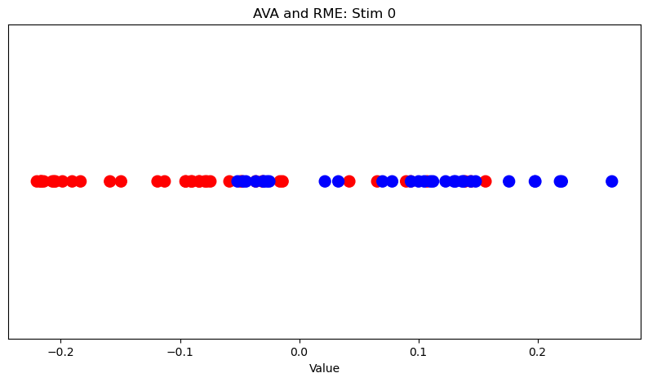
Single Axis Cluster Separation
AVA and RME stimulus_0
Hyperbolic embedding coordinates from HMDS, used 6 dimensions
Calculated mean of each dimension, within each cluster
Subtracted one from the other
Took dot product of each cell vector with the normalized average

Slide 20
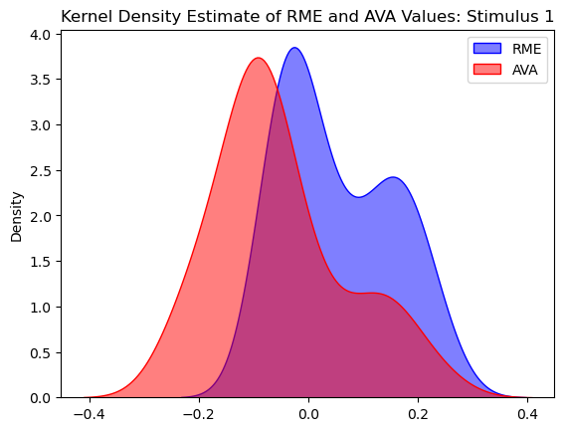
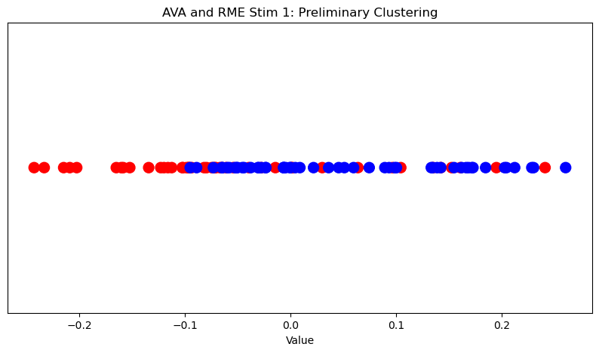
BIC: 6 for both

Slide 21
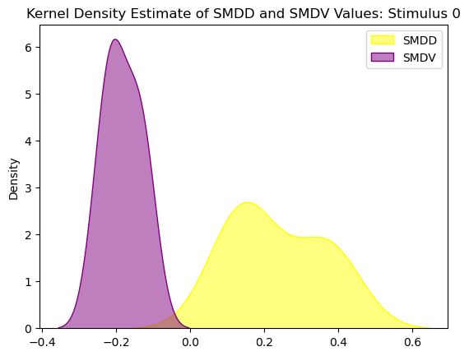
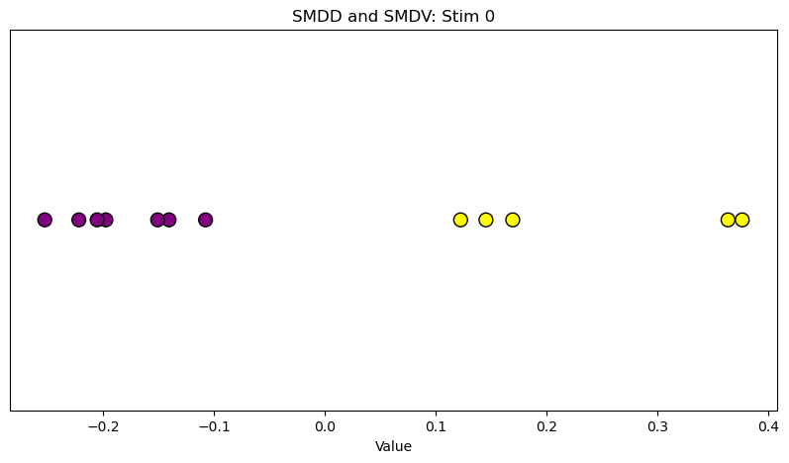
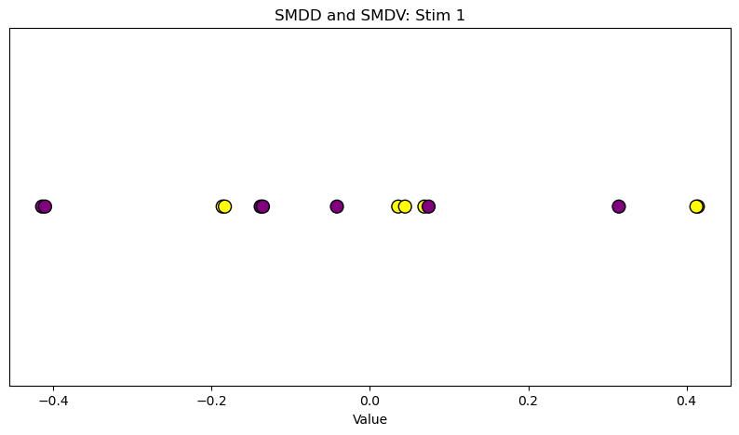
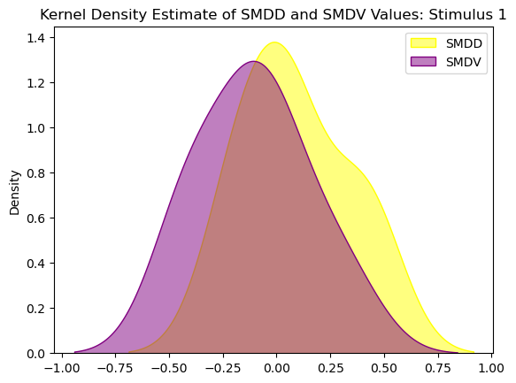
BIC: 3 for both

Slide 22
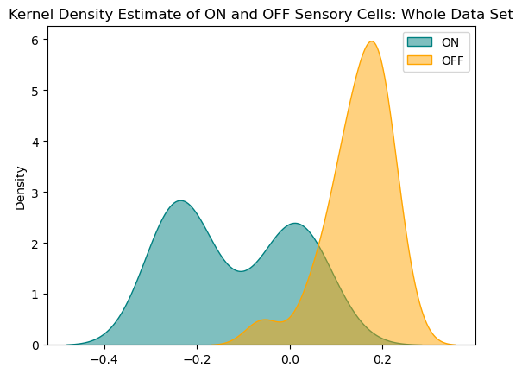
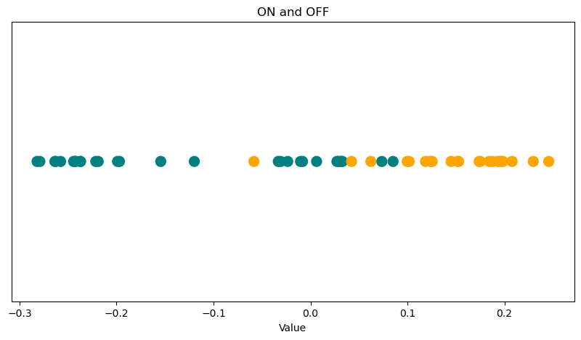
ON and OFF cells, both stimuli

Slide 23
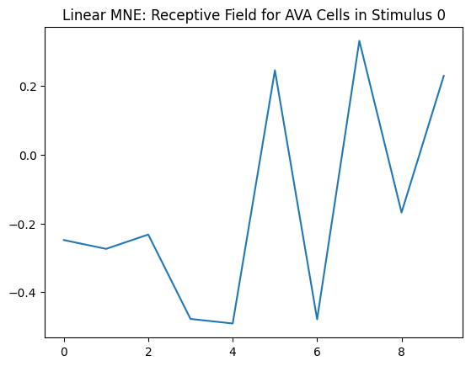
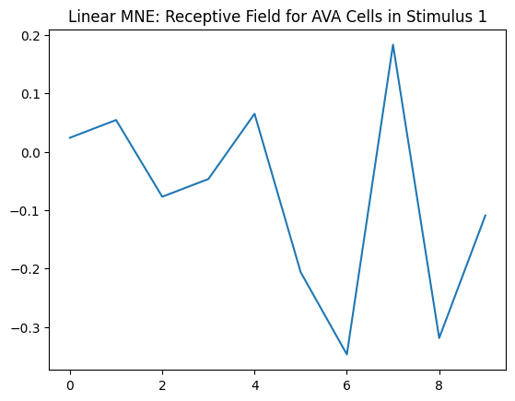
MNE Linear
Example cell: AVA Cells under stimulus 0 and 1

Slide 24
MNE: quadratic

